Slide 1

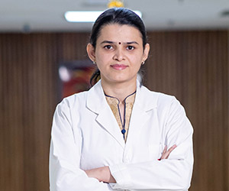
Dr. Vineeta Kharb
MBBS, MS
Female and male infertility management, Advanced ART techniques, Minimally Invasive Surgery, High risk Obstetrics, Maternal and Fetal Medicine
Sr. Consultant - Infertility/IVF Specialist
Metro Heart Institute with Multispecialty Faridabad
EDUCATION
MBBS – BRD Medical College Gorakhpur
MS (OBG) – SN Medical College Agra
Ficole in laparoscopy from Ruby hall clinic pune
F.mas IN laparoscopy from world laparoscopy Hospital
FNB 2 years fellowship of national board in Reproductive medicine from Ruby Hall Clinic Pune.
EXPERIENCE
3 Years of senior residency from Government hospital Delhi
Worked as clinical associate BL kapoor super speciality hospital Delhi.
Worked as a fellow for 2 Years at Ruby Hall Clinic Pune
OPD TIMINGS
Mon to Sat: 10:00 am to 04:00 pm
Call 0129 4277777 to book an appointment
Metro Heart Institute With Multispeciality
Sector 16A, Faridabad (HR)
www.metrohospitalfaridabad.com

